Slide 1
Seam Carving – Graphics Programming Assignment 05
Akarsh Kumar

Slide 2

Image Used

Slide 3
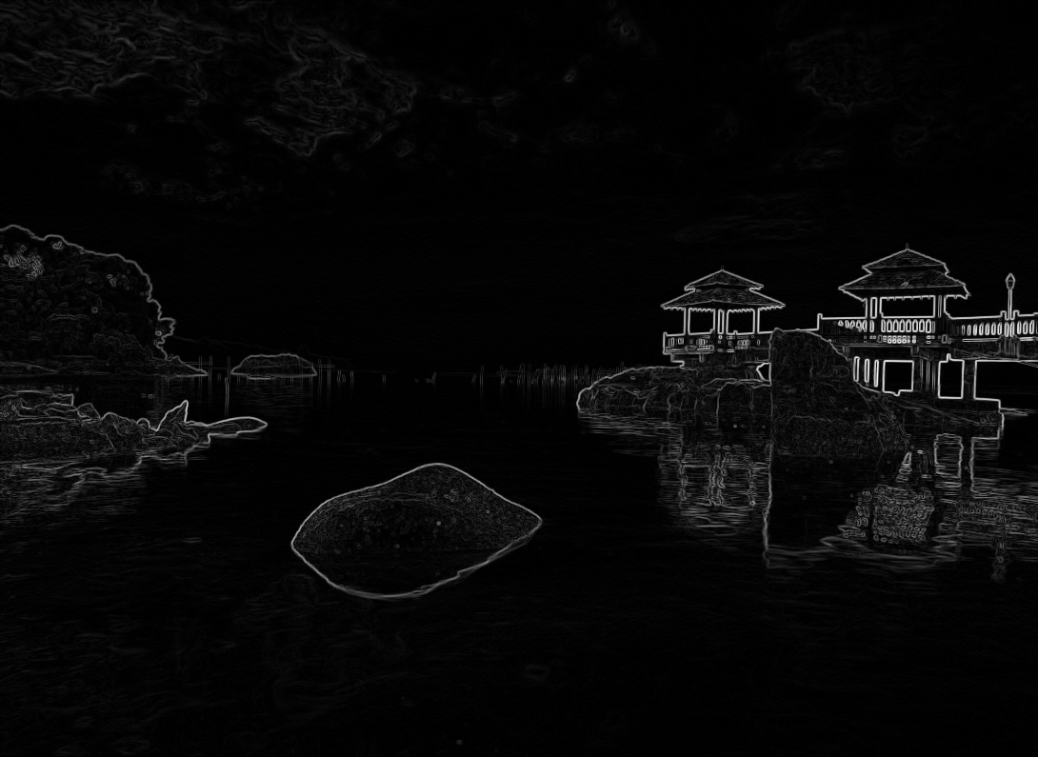
Energy Map
pic_1_a.png
Vertical and Horizontal edge detection kernels used on image
Results were combined using a Pythagorean combination technique because it is a natural and distributive way to combine two transformed images
Code:
Iy=cv2.filter2D(img*1.0,-1,edge_kernel)
Ix=cv2.filter2D(img*1.0, 1,edge_kernel.T)
I=(Ix*Ix+Iy*Iy)**.5

Slide 4
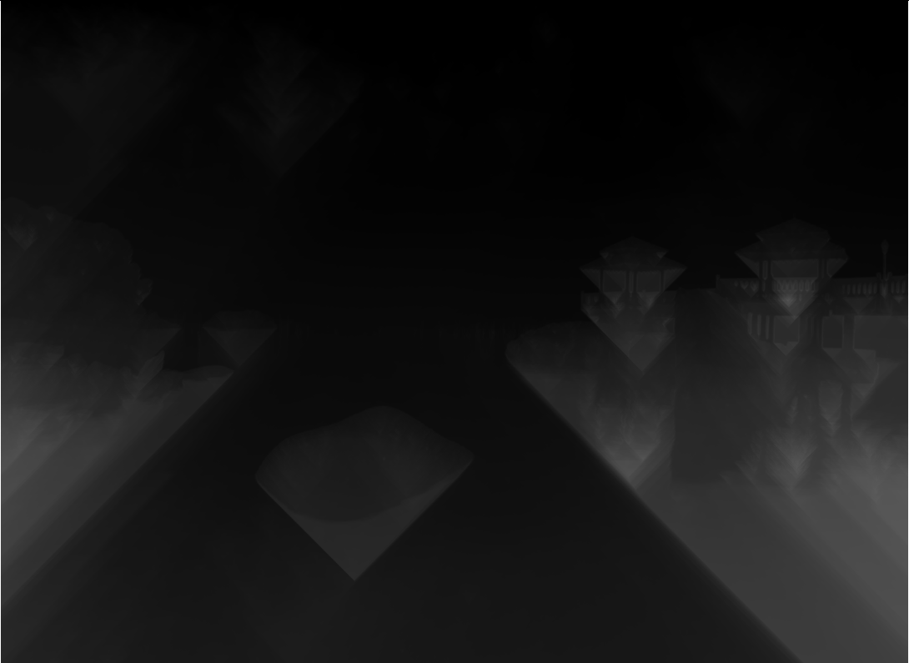
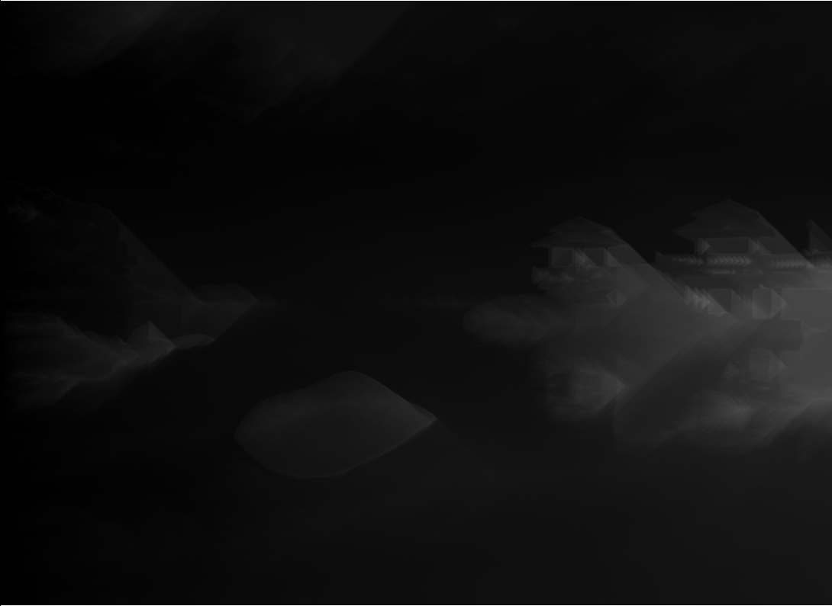
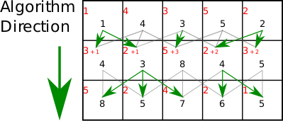
Dynamic Programming
pic_1_b.png
Dynamic Programming was used to find the values to place optimal seams vertically and horizontally
pic_1_b_hor.png

Slide 5


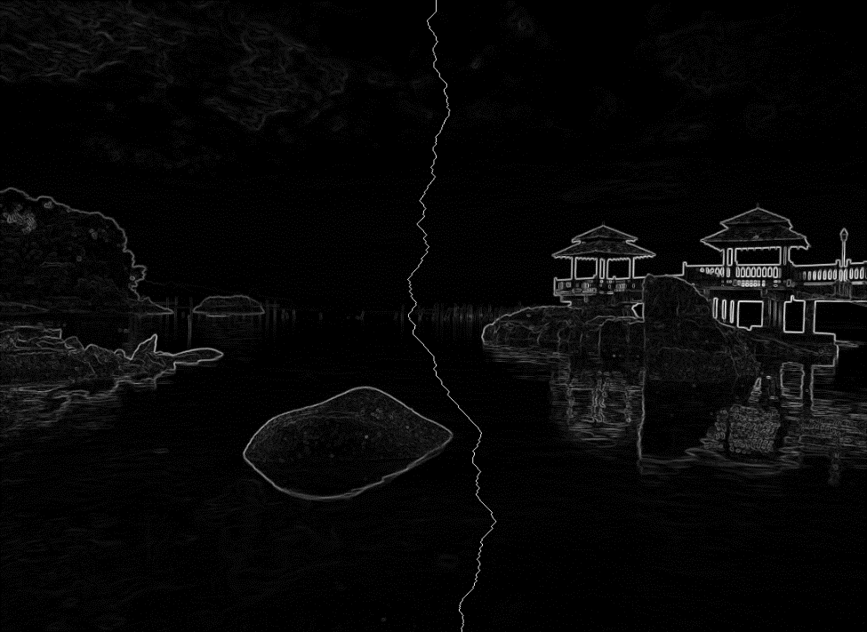
First Vertical Seam
Vertical seam found using smallest values in the dynamic maps
pic_1_c_0.png
pic_1_c_2.png
pic_1_c_1.png

Slide 6


Removed Vertical Seams
1 and 50 vertical seams were removed:
pic_1_d.png
pic_1_e.png

Slide 7

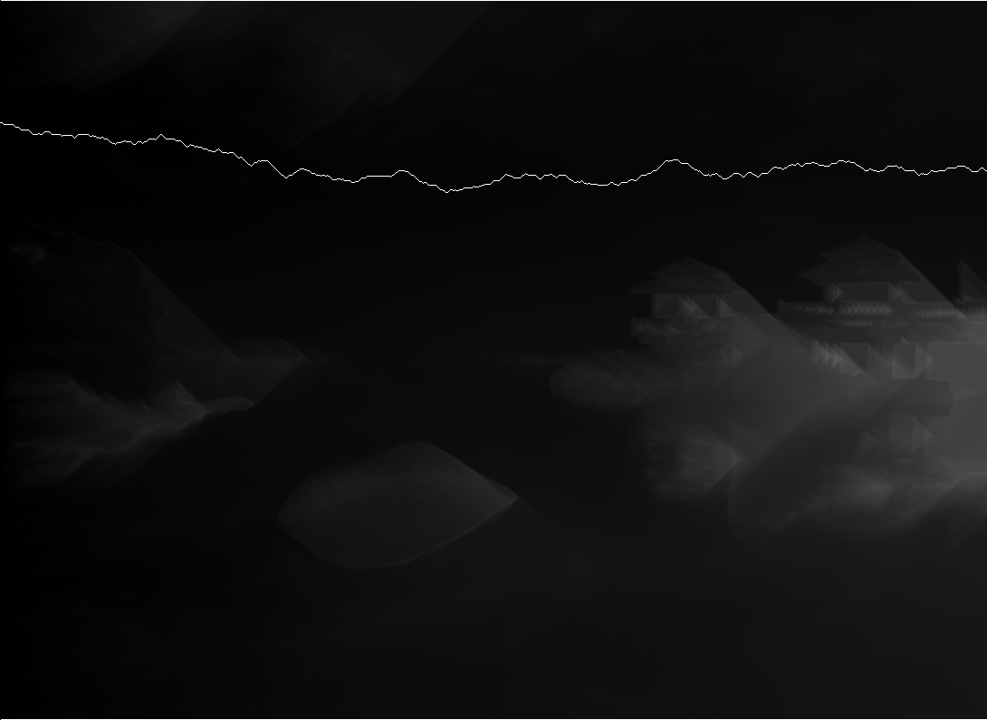
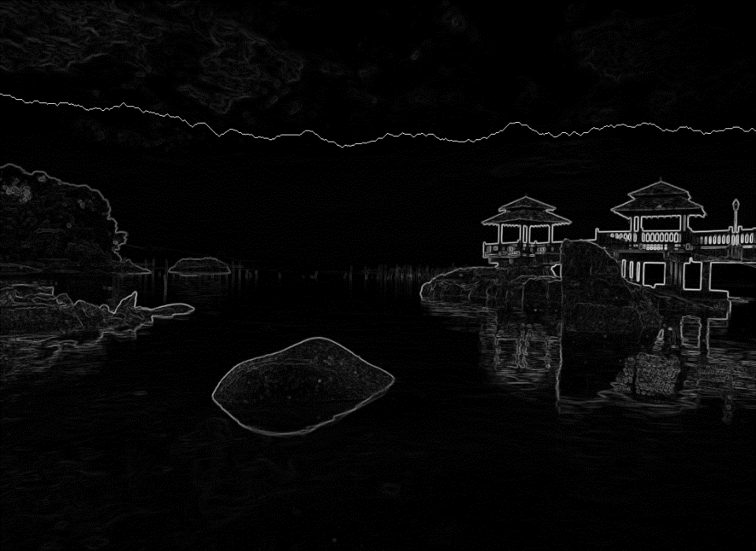
First Horizontal Seam
Horizontal seam found using smallest values in the dynamic maps
pic_2_a_0.png
pic_2_a_2.png
pic_2_a_1.png

Slide 8

Removed Horizontal Seams
50 horizontal seams were removed:
original
pic_2_b.png

Slide 9




Retargeted Images
Repeated seam removals were used the change the dimensions of the image
Image started from a dimension of 1090x795
pic_3_b_1.png (320x320)
pic_3_b_0.png (320x240)
pic_3_b_2.png (640x480)
pic_3_b_3.png (640x640)

